Slide 1
MODELS OF THE NEURON Project 2
The TMNT • 12.06(or 08?).2017
Jing Xuan Lim | Simon Orozco | Seony Han
Notes:
Presentation: 10 min
Questions: 2 min

Slide 2
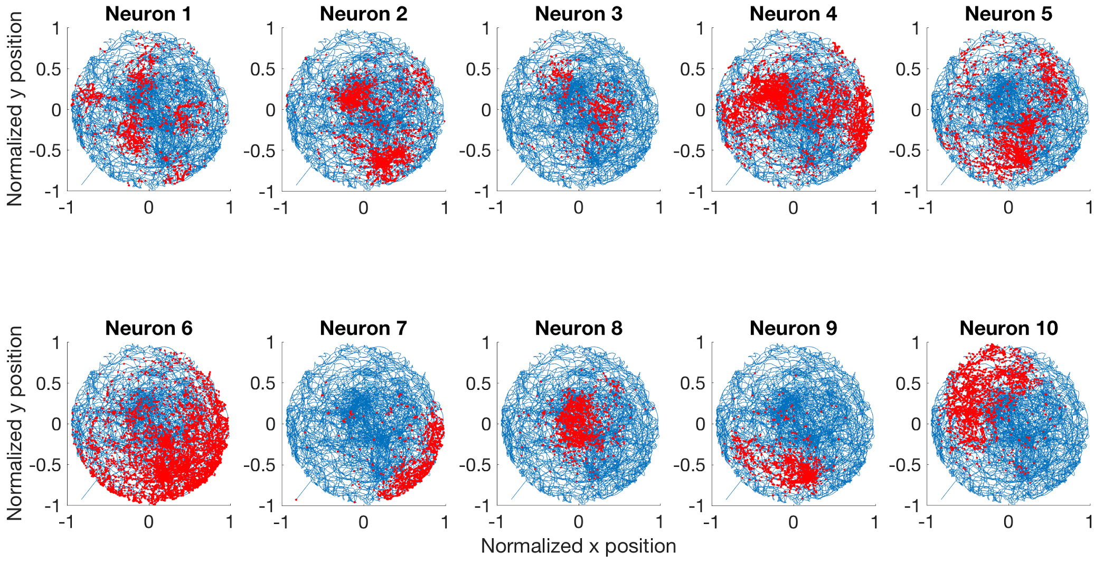
Spiking activities of unimodal and multimodal place cells
Multimodal place cells
Unimodal place cells

Slide 3
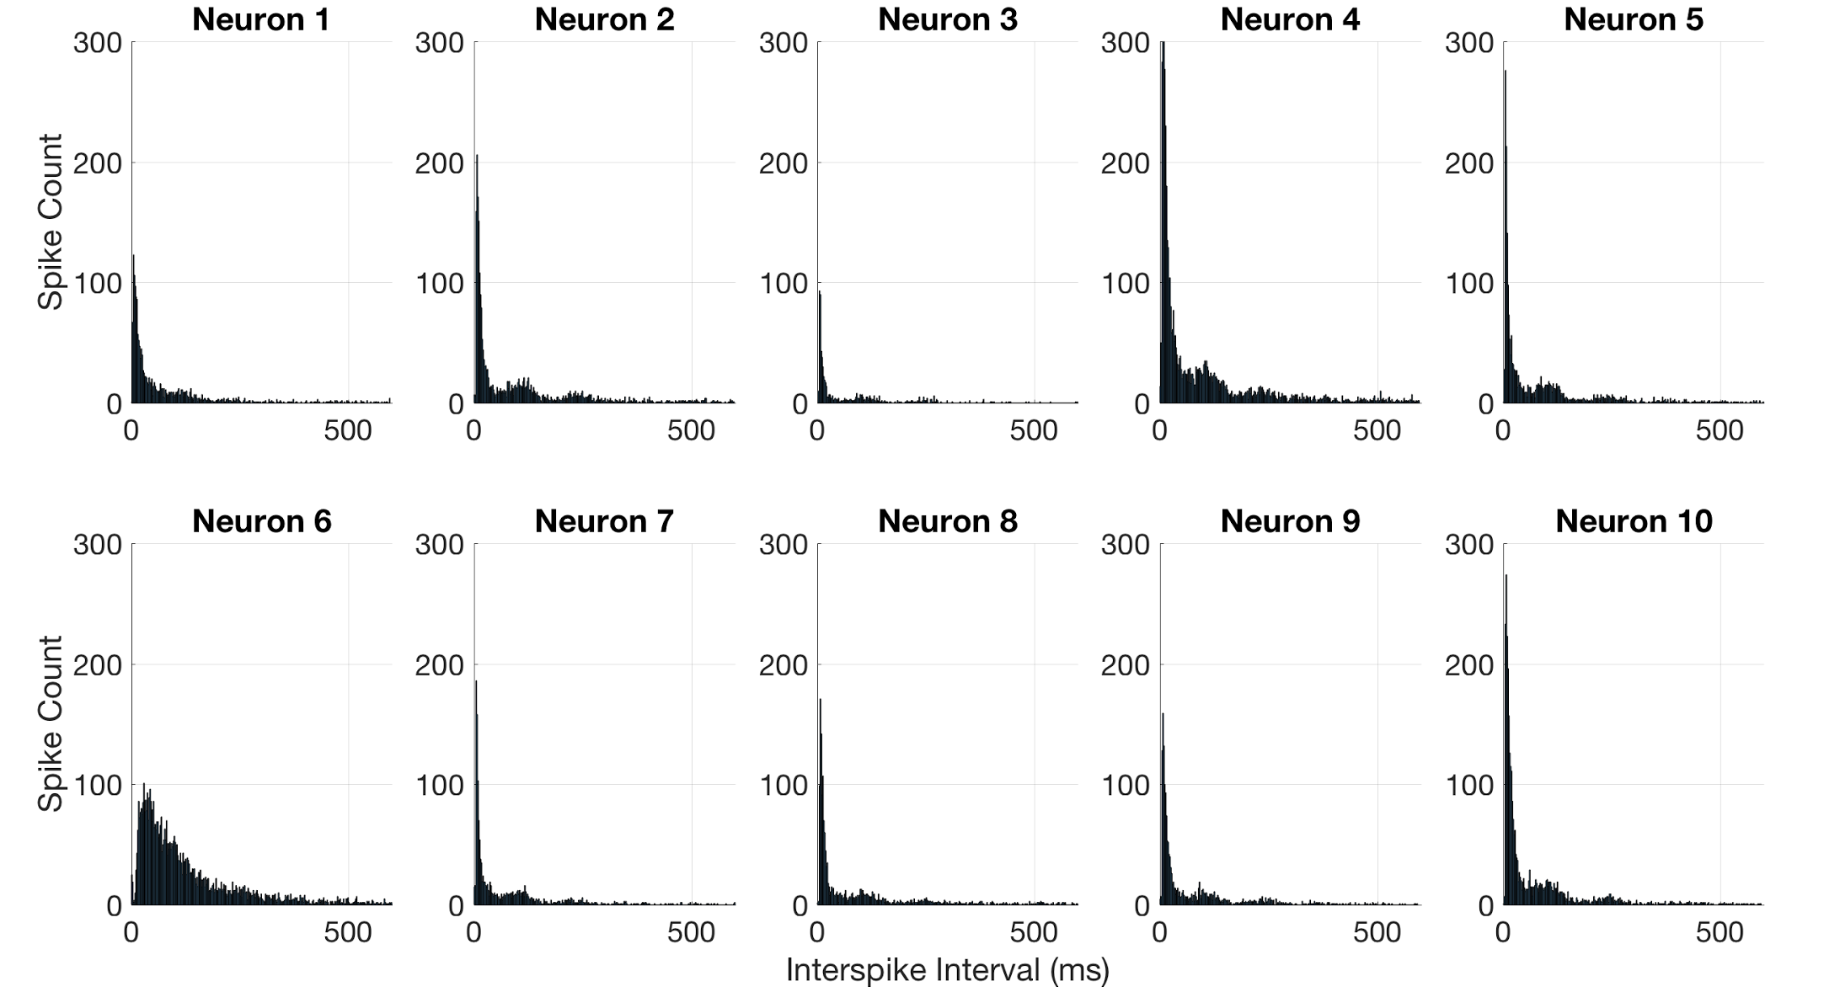
Interspike intervals of spiking activity
Model 2
Model 1
Model 3
Notes:
Talk about history dependence

Slide 4
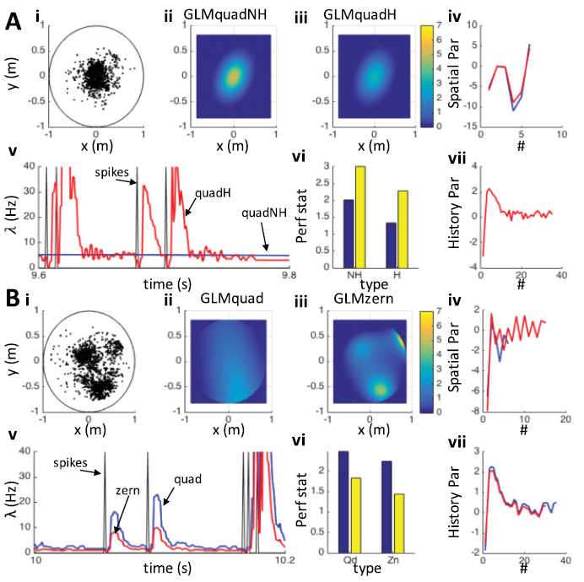
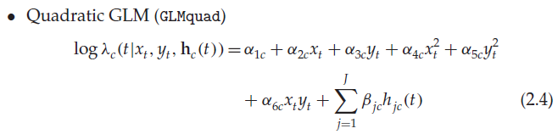
Base model: positional covariates + history dependence
What is the history dependence?
Are there other covariates that explain spiking activity?
Agarwal et. al (2016)

Slide 5
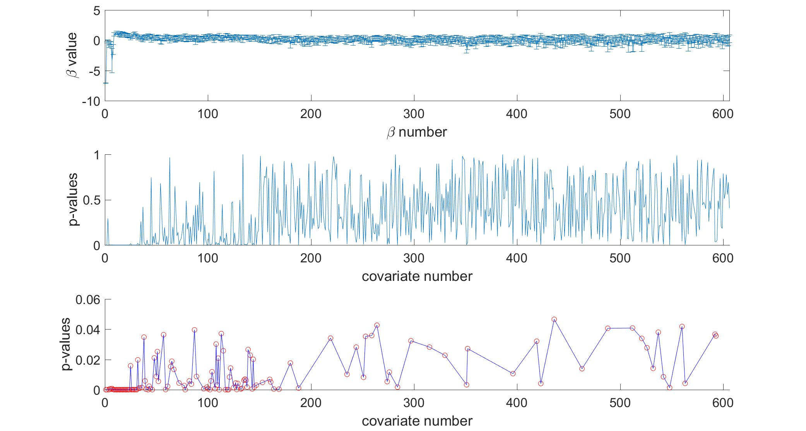
Parameterizing history dependence: significant p-values

Slide 6
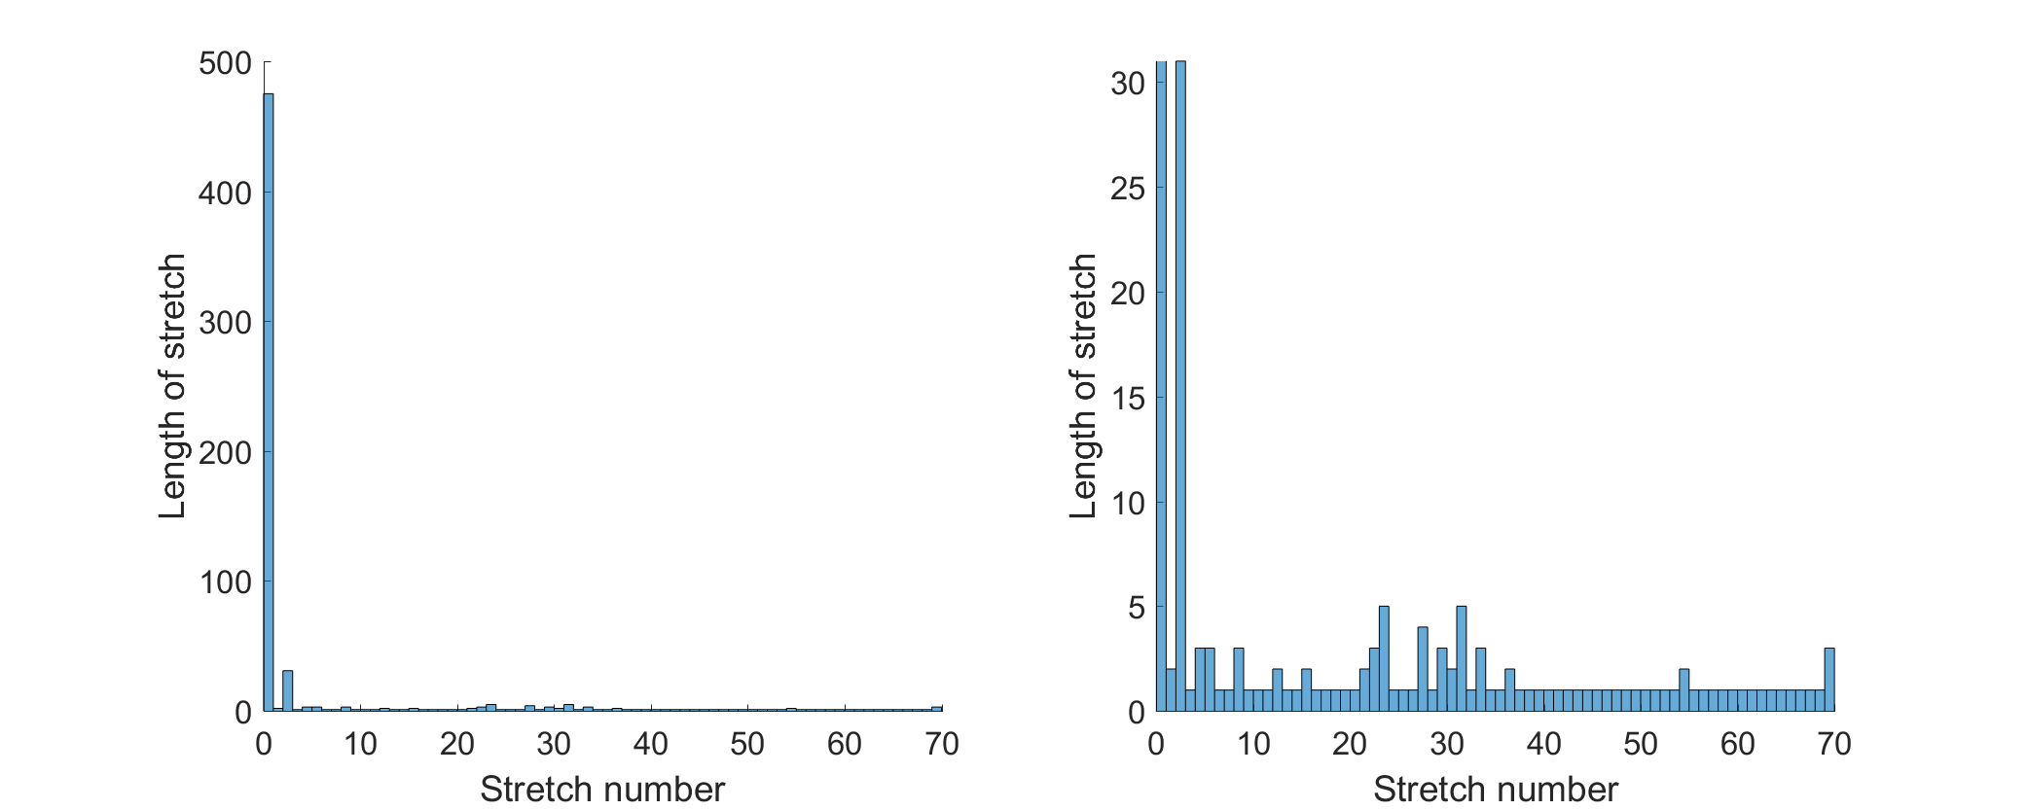
Parameterizing history dependence: stretches of significant p-values
everything else

Slide 7
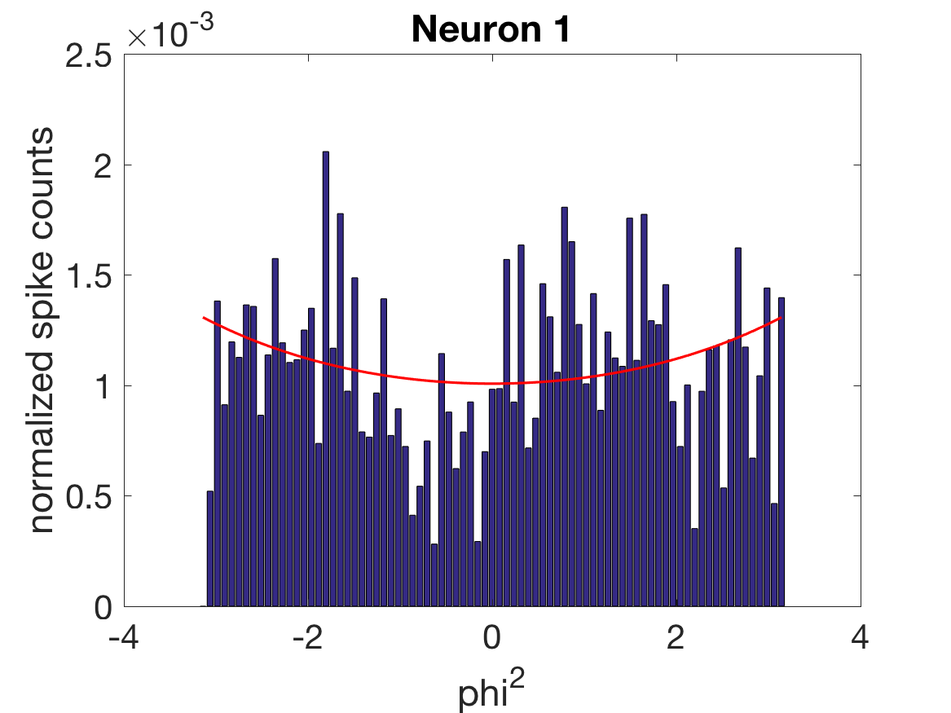
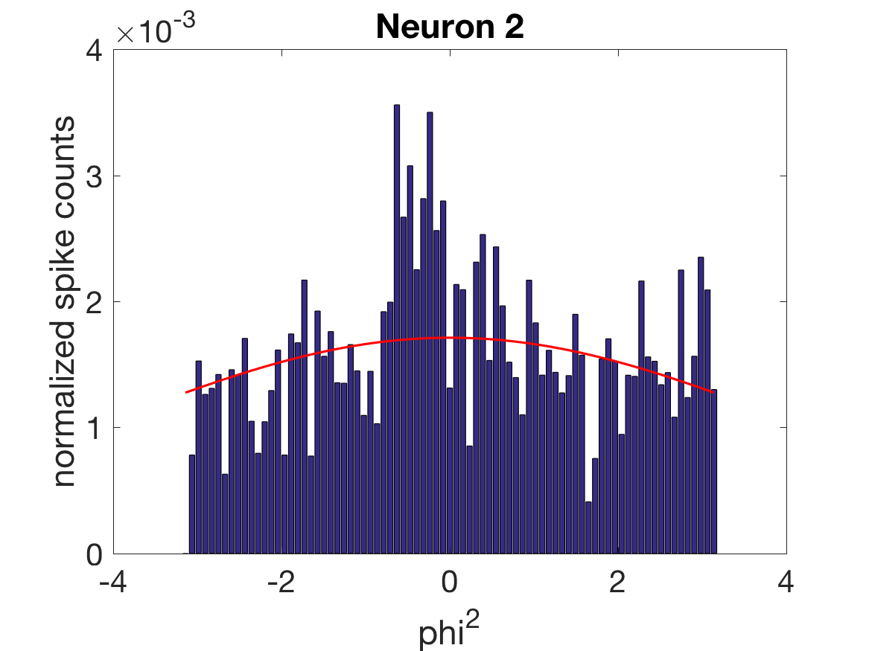
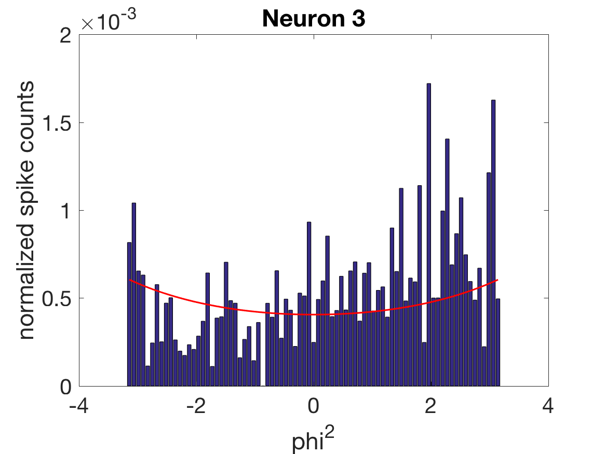
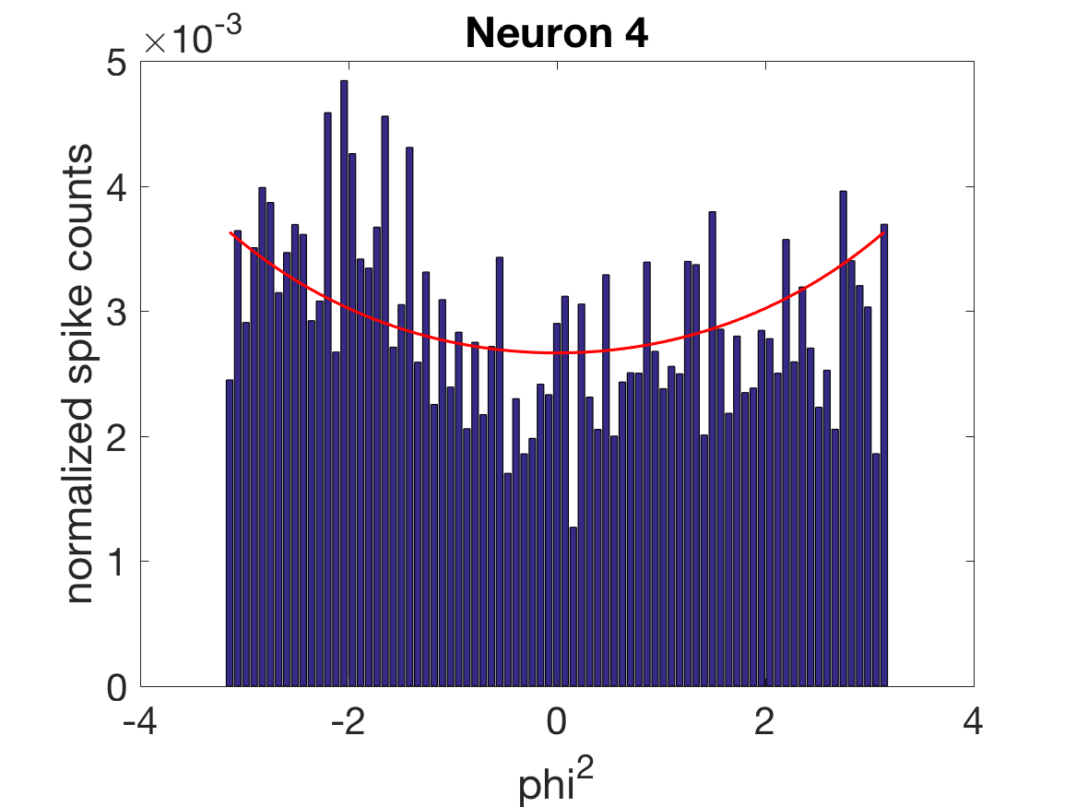
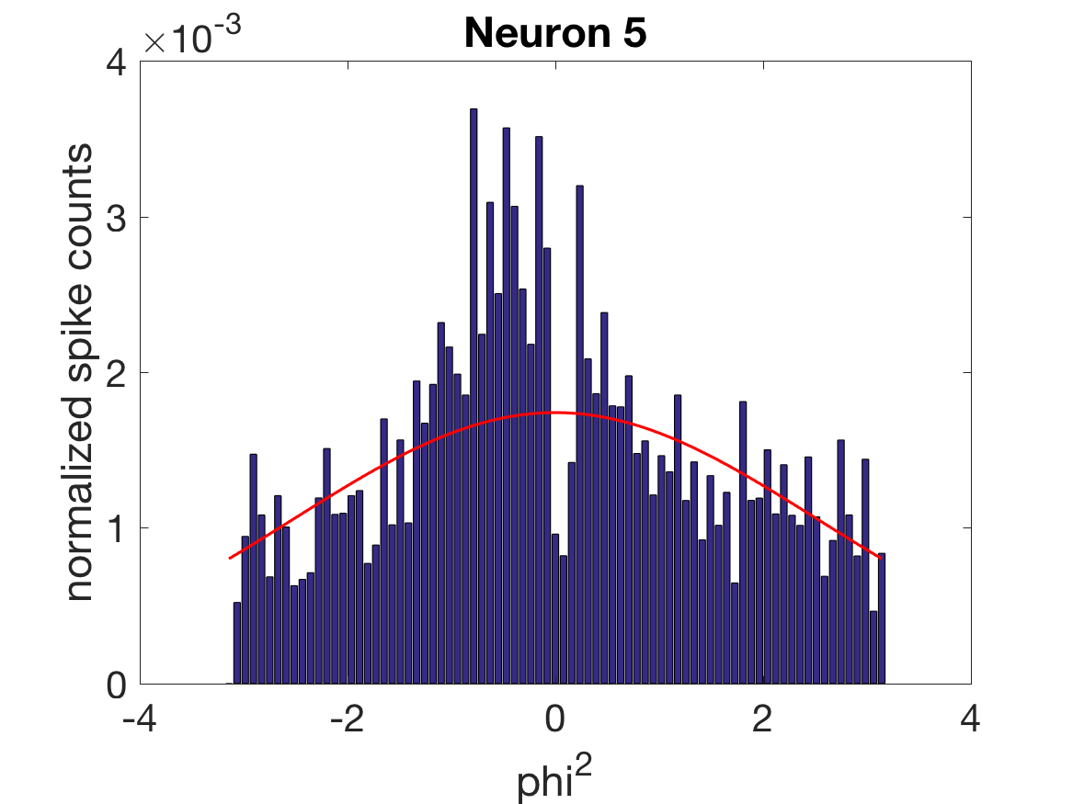
Head direction (phi) is quadratically-correlated with firing rates of multimodal cells

Slide 8
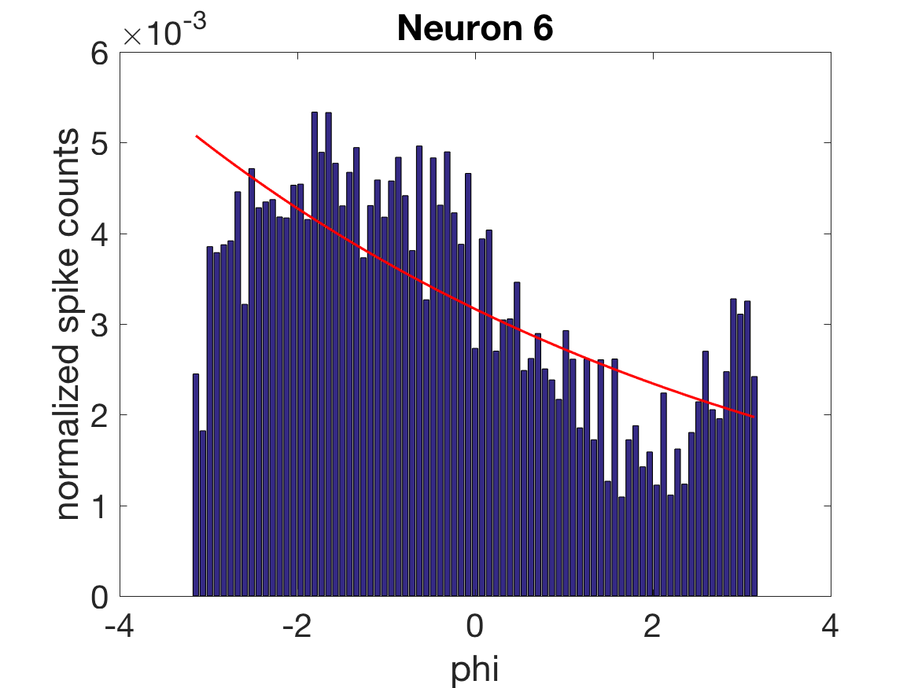
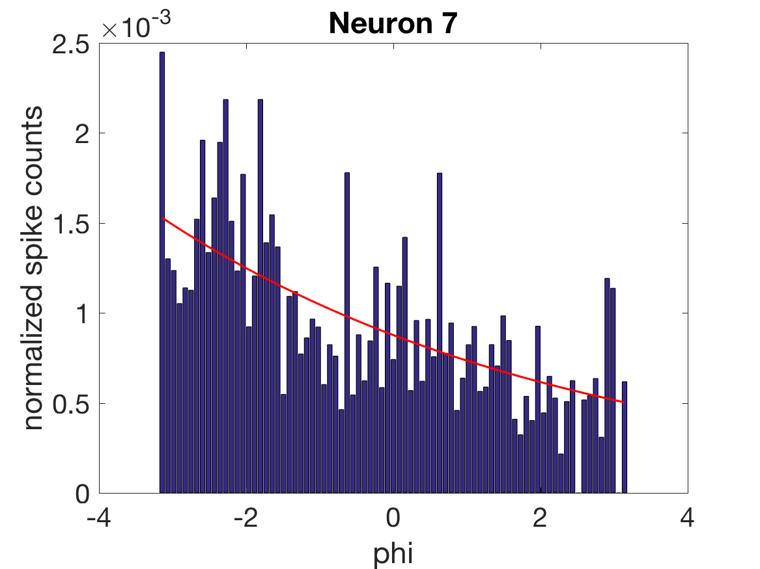
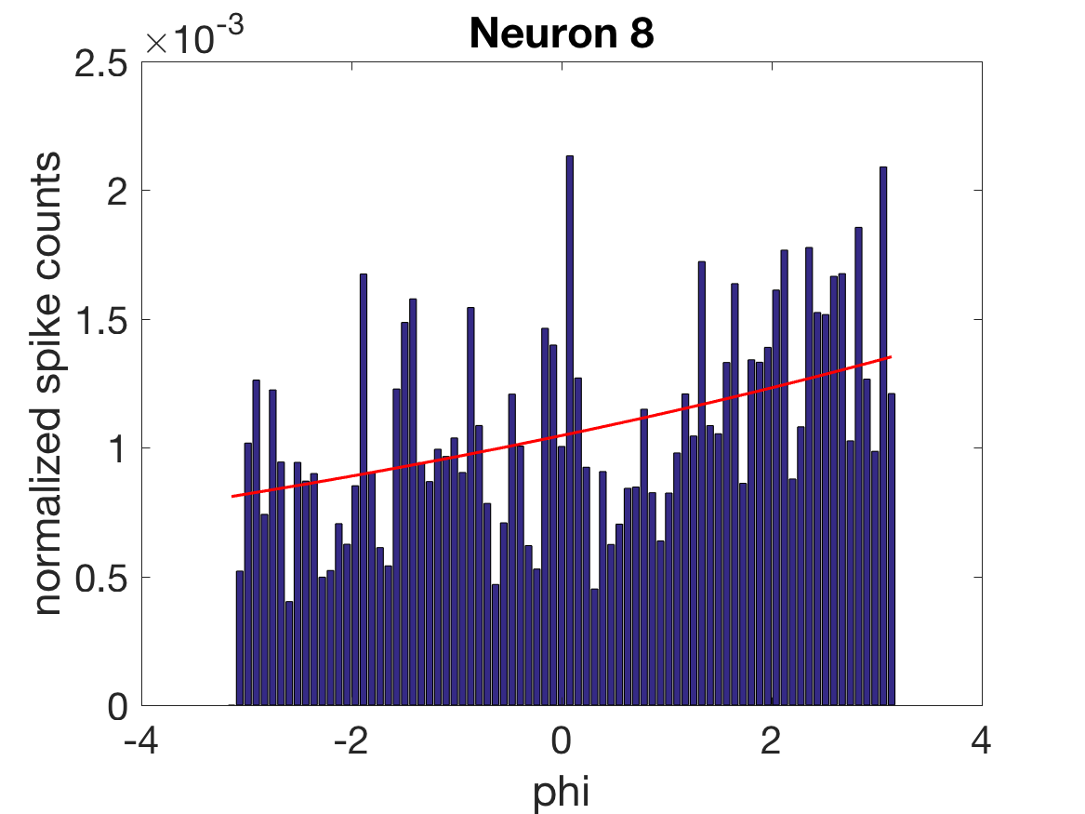
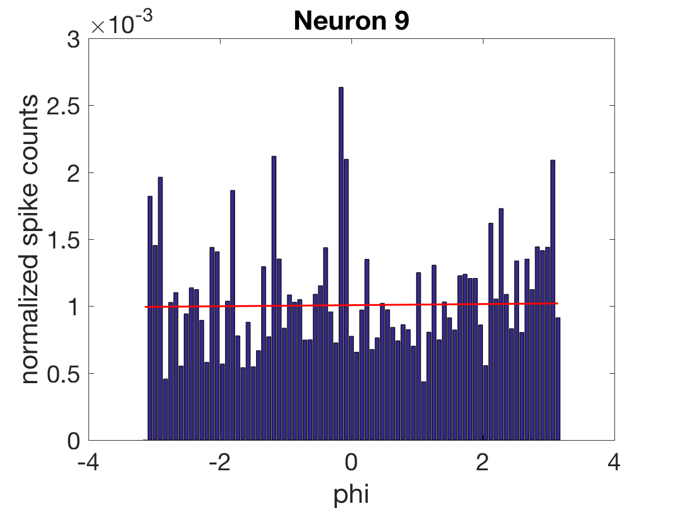
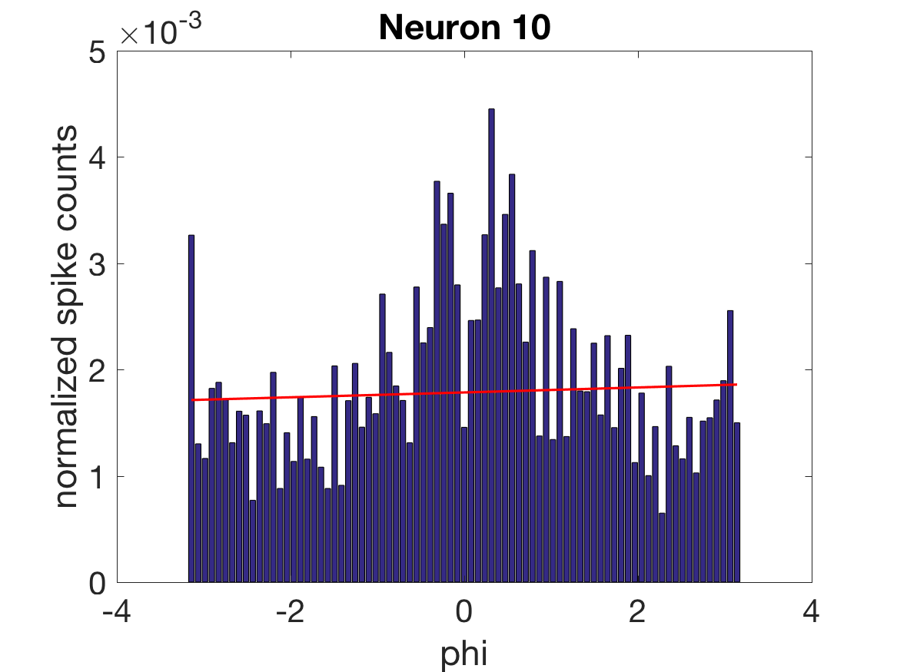
Head direction (phi) is linearly-correlated with firing rates of unimodal cells

Slide 9
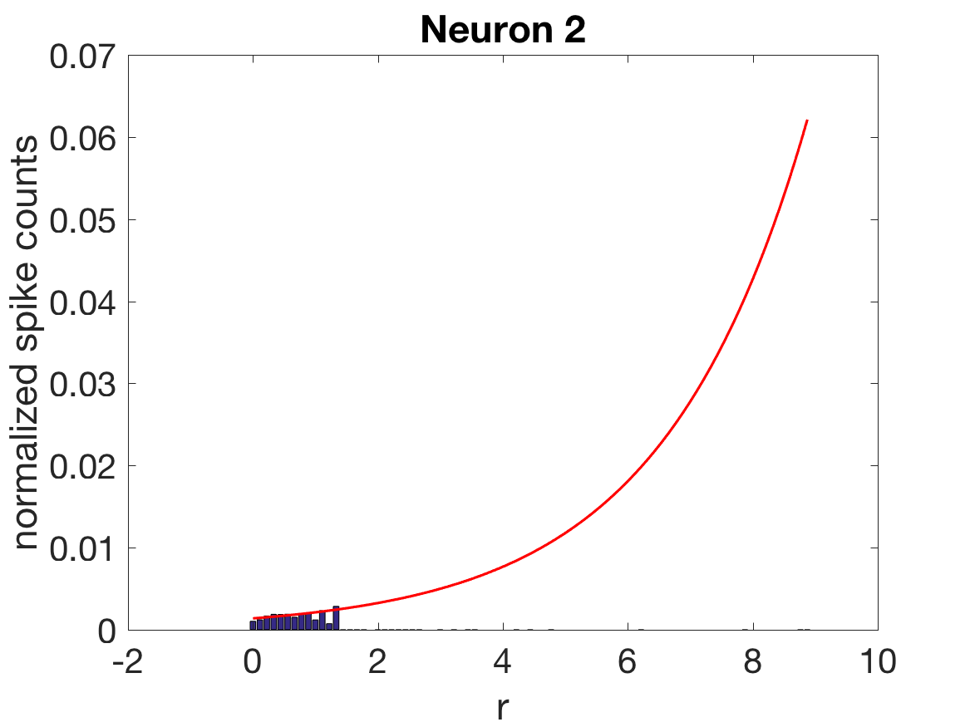
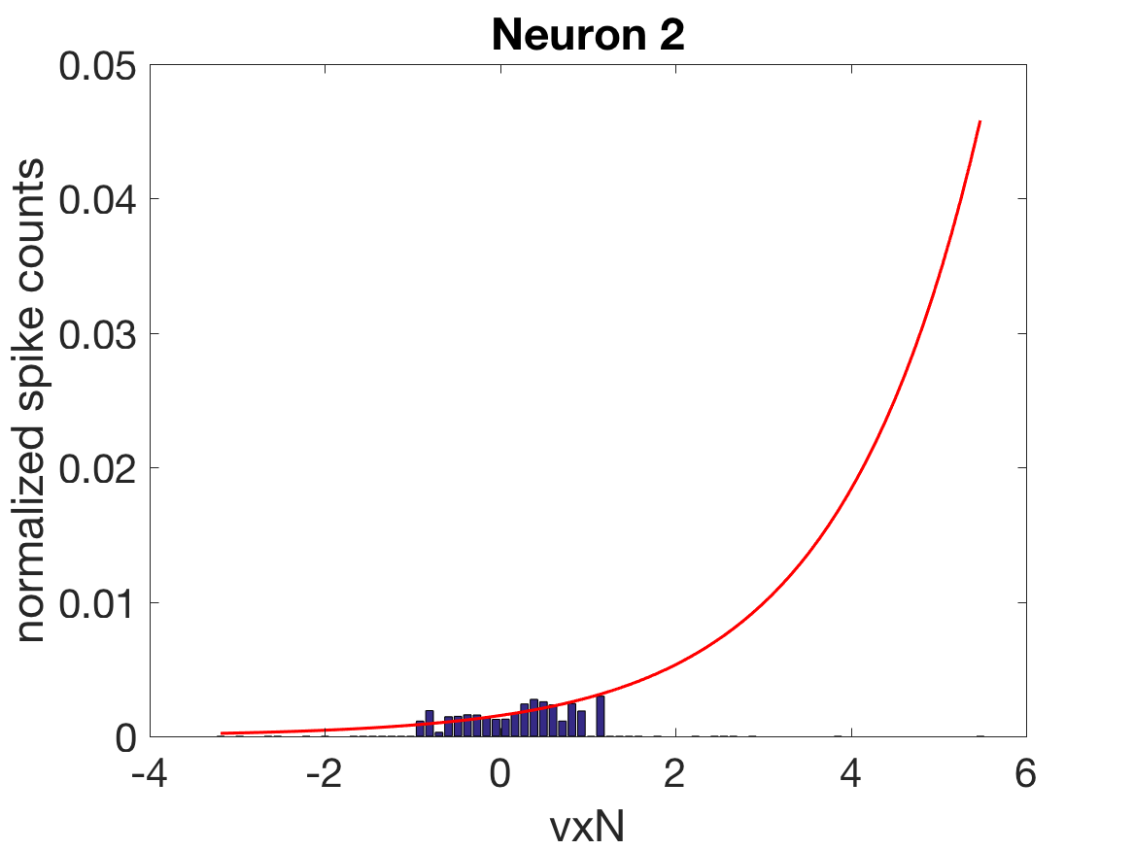
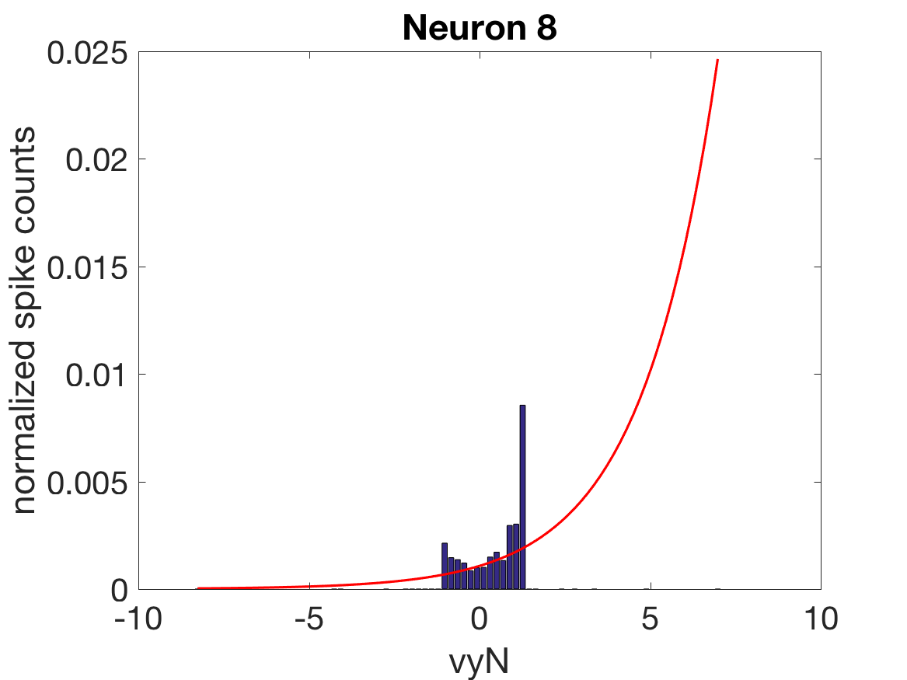
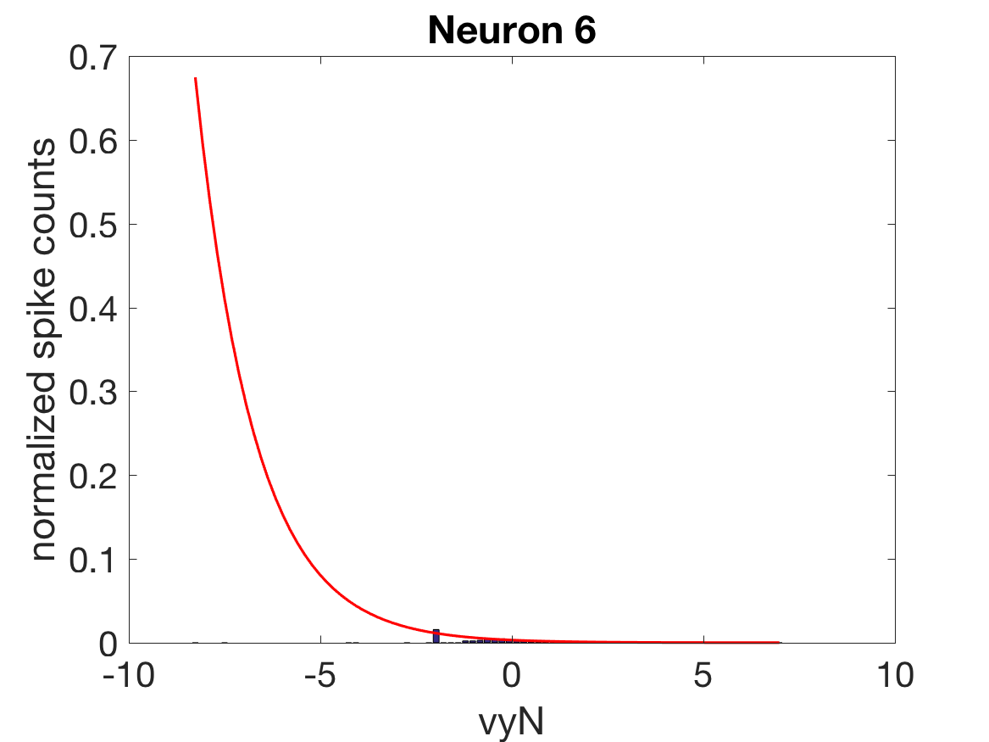
Unable to determine correlation of velocities (vxN, vyN) and speed (r) with firing rates

Slide 10
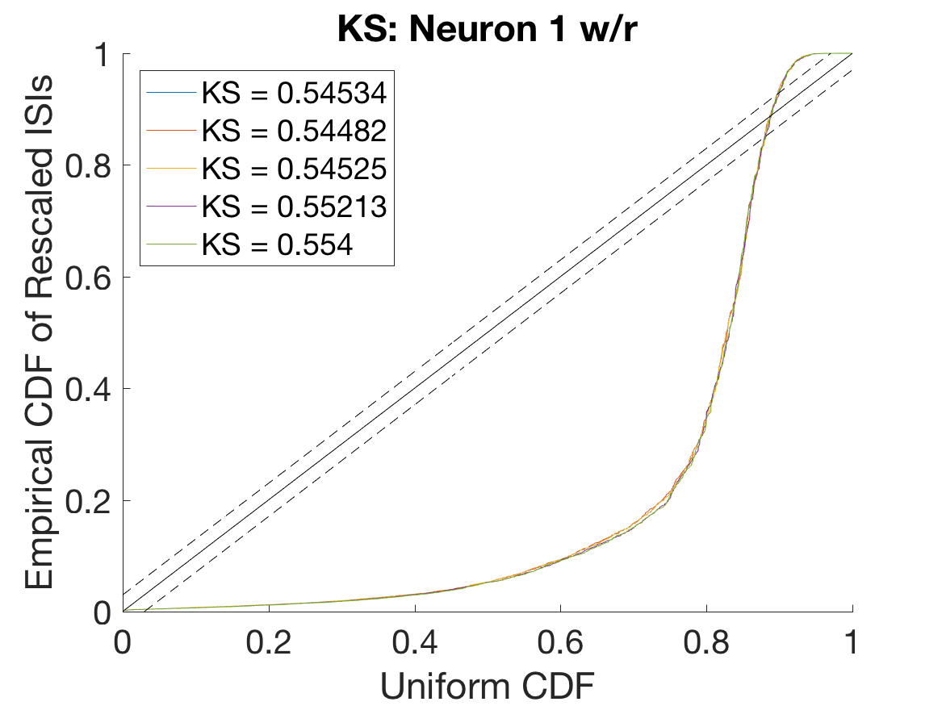
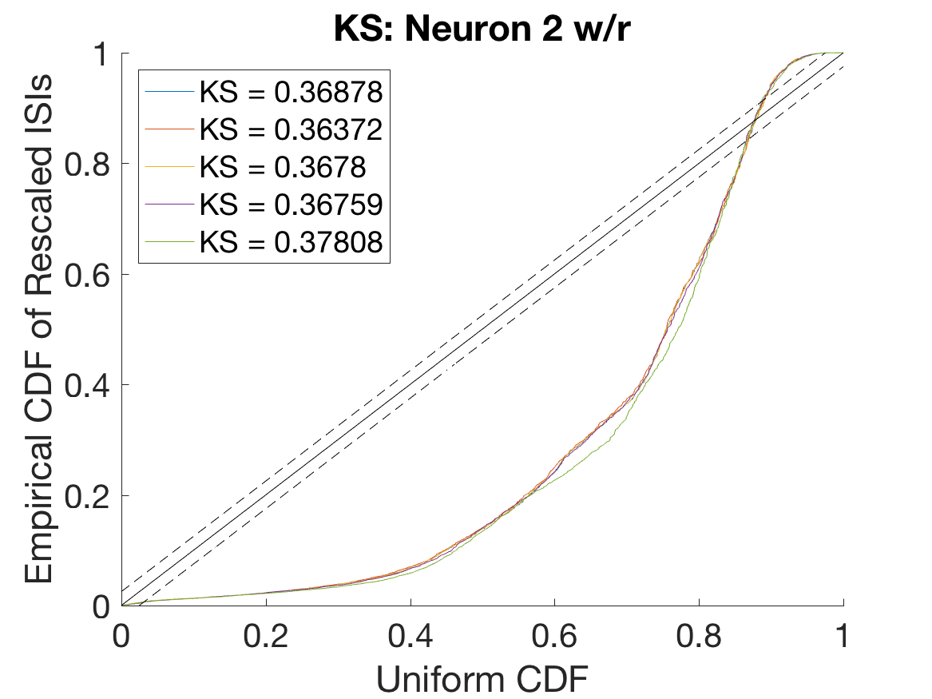
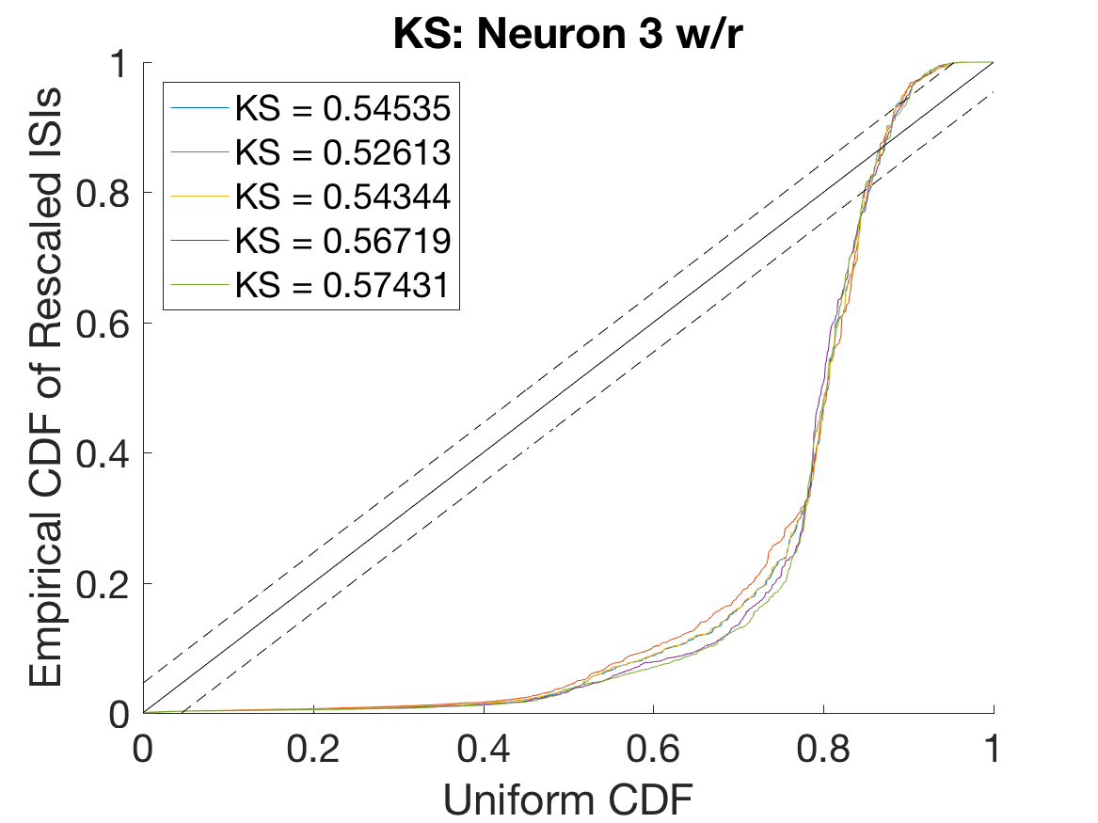
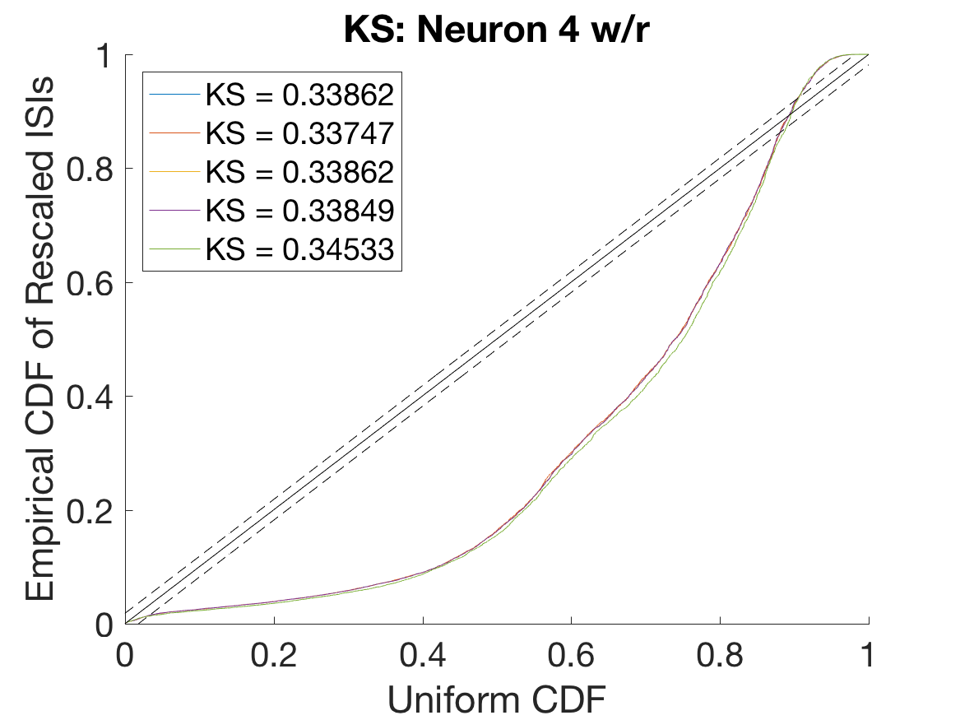
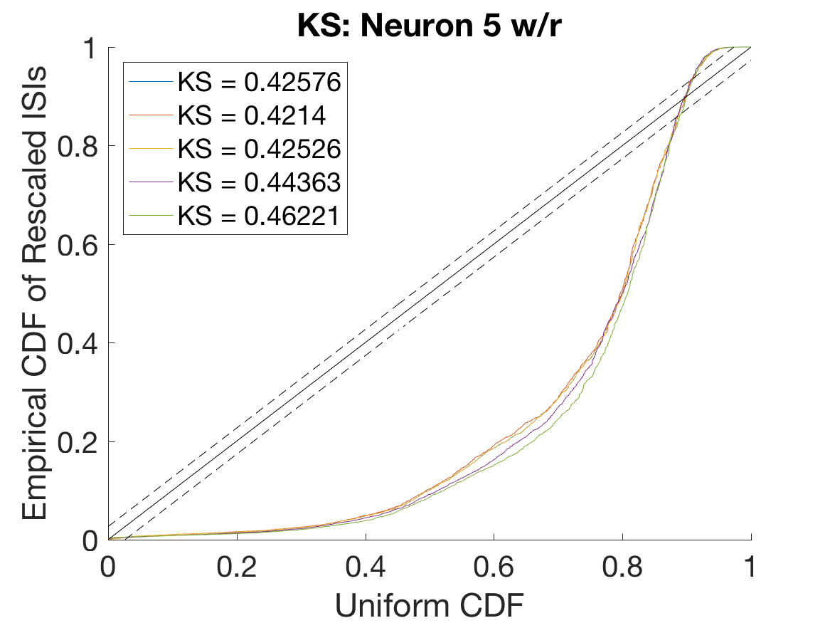
Speed (r) contributes a model in explaining multimodal cell firing
Base = xN, yN, xN2, yN2, xN*yN
Base
Base, r
Base, r2
Base -xN
Base -xN - yN

Slide 11
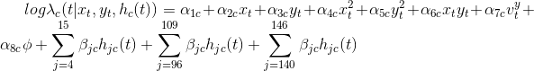
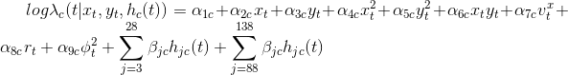
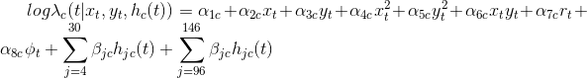
Generalized Linear Models (GLMs)
Model 1
Model 2
Model 3

Slide 12
Results

Slide 13
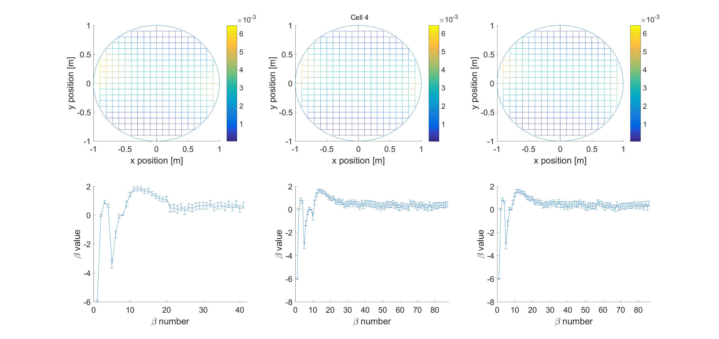

High dependence on x and y coordinate and moderate dependence on short term history

Slide 14
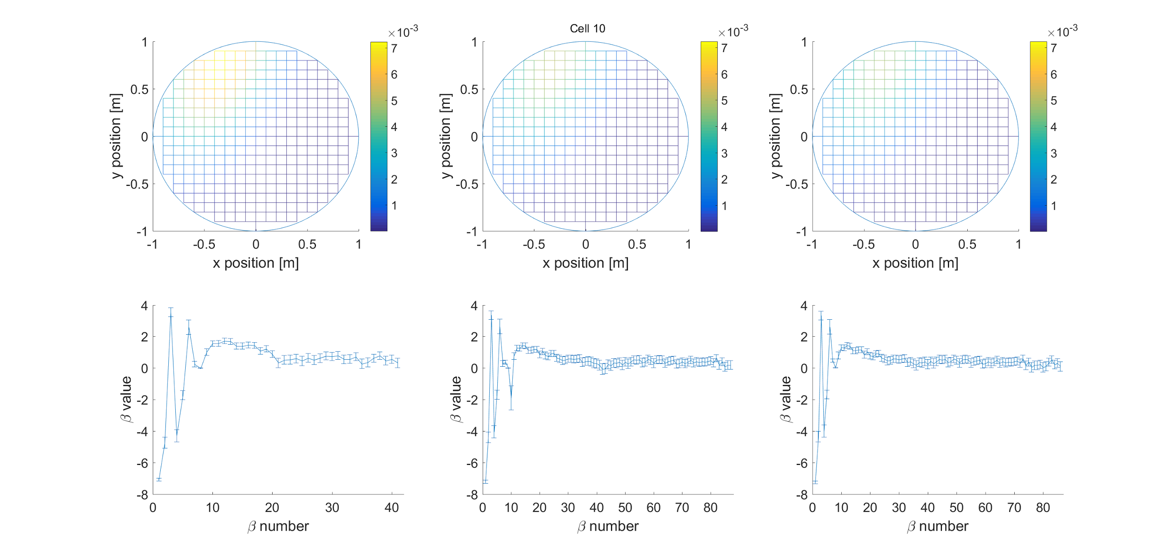
High dependence on x and y coordinate and moderate dependence on short term history

Slide 15
What are the cells encoding?
xN: strong
yN: strong
xN²: strong
yN²: strong
xN·yN: strong
Speed (r): moderate (unimodal), low (multimodal)
Heading (phi): low (unimodal/multimodal)
Velocity (vxN, vyN): low (unimodal/multimodal)
Short term history (5-20 ms): moderate-to-strong
Medium term history (90-140): low
Long term history: very low

Slide 16
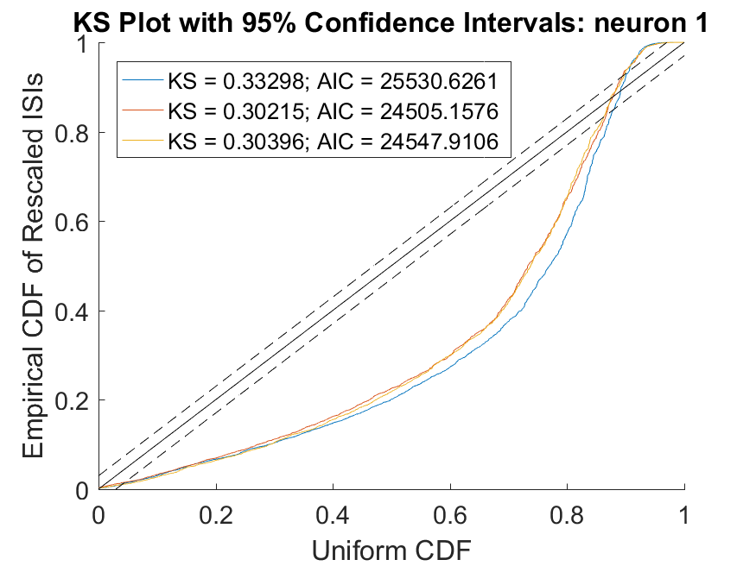
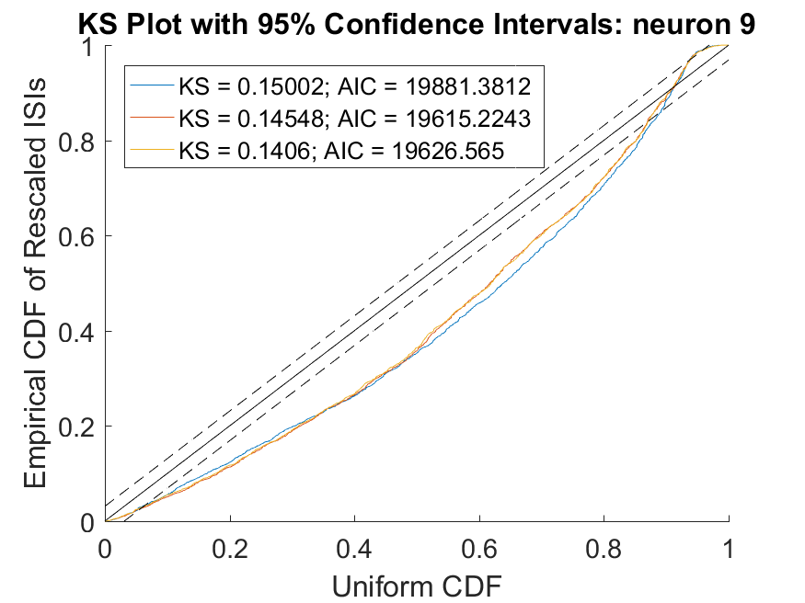
Models were able to better explain spiking activity of neurons they were made for

Slide 17
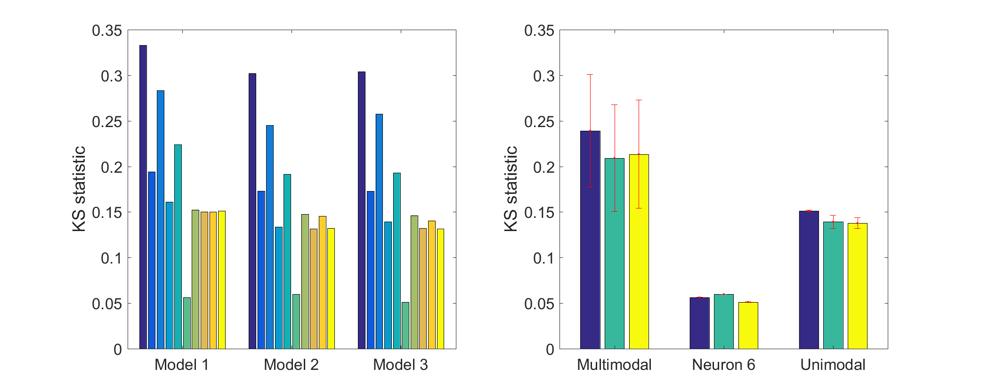
Models better explained unimodal neurons than multimodal neurons

Slide 18
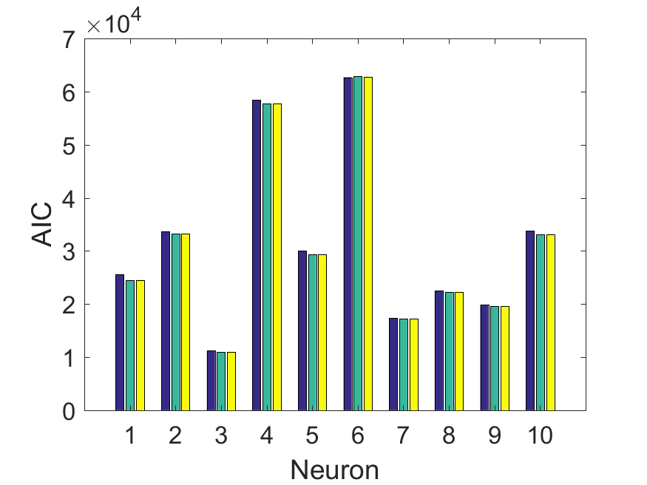
Model 1 is relatively better in explaining the data for all neurons
Number of covariates
Model 1 | 39
Model 2 | 84
Model 3 | 84

Slide 19
Conclusions
We constructed 3 GLMs which performed better for the neurons they were constructed for
Model 1 → neuron 6
Model 2 → neurons 1-5
Model 3 → neurons 7-10
Model 1 performed best when comparing relative goodness-of-fit due to low number of covariates
Positional covariates had the most explanatory power
All the neurons showed some history dependence between 5-20 ms in the past as well as around 90-140 ms
Notes:
Acknowledgements: thank Macauley, Rai

Slide 20
References
Agarwal, R., Chen, Z., Kloosterman, F., Wilson, M.A., and Sarma, S. V. (2016). A Novel Nonparametric Approach for Neural Encoding and Decoding Models of Multimodal Receptive Fields. Neural Comput. 28, 1356–1387.
Huang, Y., Brandon, M.P., Griffin, A.L., Hasselmo, M.E., and Eden, U.T. (2009). Decoding Movement Trajectories Through a T-Maze Using Point Process Filters Applied to Place Field Data from Rat Hippocampal Region CA1. Neural Comput. 21, 3305–3334.
Giocomo, L.M., Moser, M.B., and Moser, E.I. (2011). Computational models of grid cells. Neuron 71, 589–603.
Kraus, B.J., Brandon, M.P., Robinson, R.J., Connerney, M.A., Hasselmo, M.E., and Eichenbaum, H. (2015). During Running in Place, Grid Cells Integrate Elapsed Time and Distance Run. Neuron 88, 578–589.
Santaniello, S., Gale, J.T., Montgomery, E.B., and Sarma, S. V (2010). Modeling the effects of Deep Brain Stimulation on sensorimotor cortex in normal and MPTP conditions. In 2010 Annual International Conference of the IEEE Engineering in Medicine and Biology, (IEEE), pp. 2081–2084.

Slide 21

Acknowledgements
Raimond Winslow
Macauley Breault
Joseph Greenstein
Simon’s lab PC
The Sheridan Libraries (M Level)

